Slide 1
ATiNS – Week 9
The generator problem

Slide 2
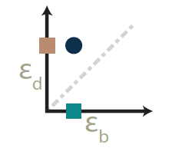

Slide 3
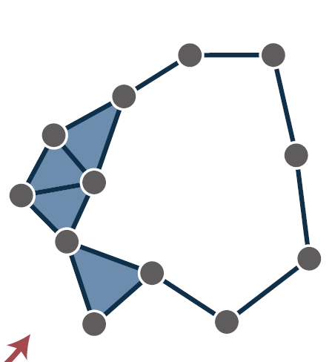

Slide 5
How do we do this?

Slide 6
Minimal representative at birth
Homologous representative at birth
Minimal representative at mid-life

Slide 7
Which is correct? Or even the best?

Slide 8
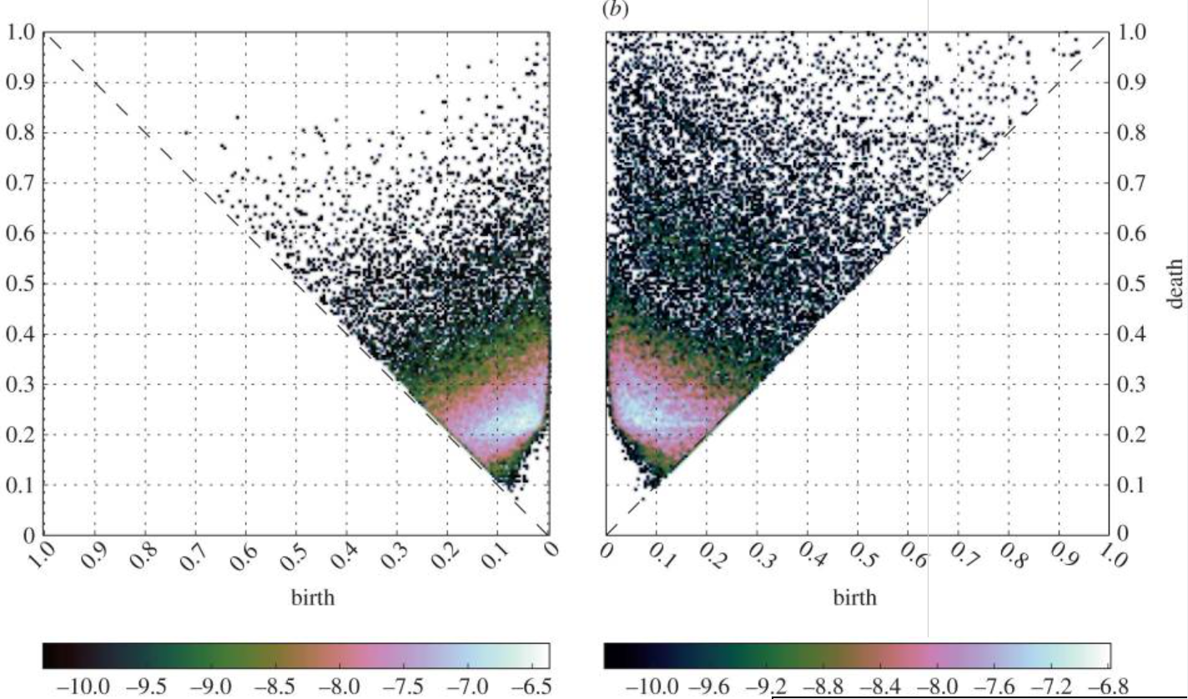
Homological scaffolds
Placebo
Psilocybin
Petri et al., 2014

Slide 9
Homological scaffolds
- make new network with edge weights defined by the 1) number and 2) persistence of persistent cycles using this edge.
Petri et al., 2014

Slide 10
Homological scaffolds
- make new network with edge weights defined by the 1) number and 2) persistence of persistent cycles using this edge
Which representative to choose??
Javaplex output – pro: computationally feasible, con: not necessarily geometrically nice
Petri et al., 2014

Slide 11
Homological scaffolds
Placebo
Psilocybin
Petri et al., 2014

Slide 12
All minimal representatives at birth

Slide 13
All minimal representatives at birth
2 minimal cycles!!

Slide 14
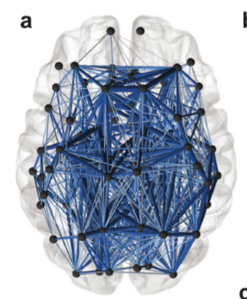
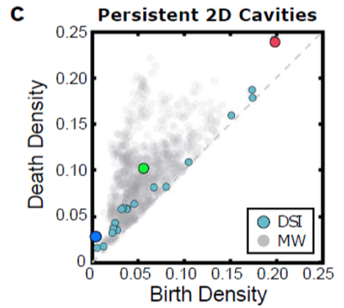
What really happens?
Sizemore et al., 2017

Slide 15
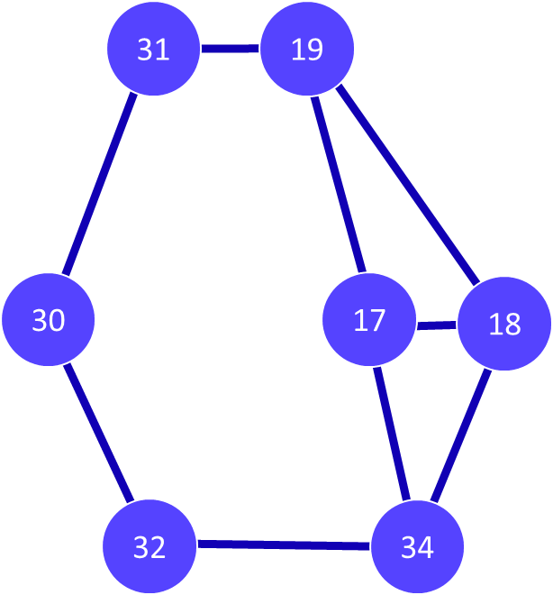
What really happens?

Slide 16
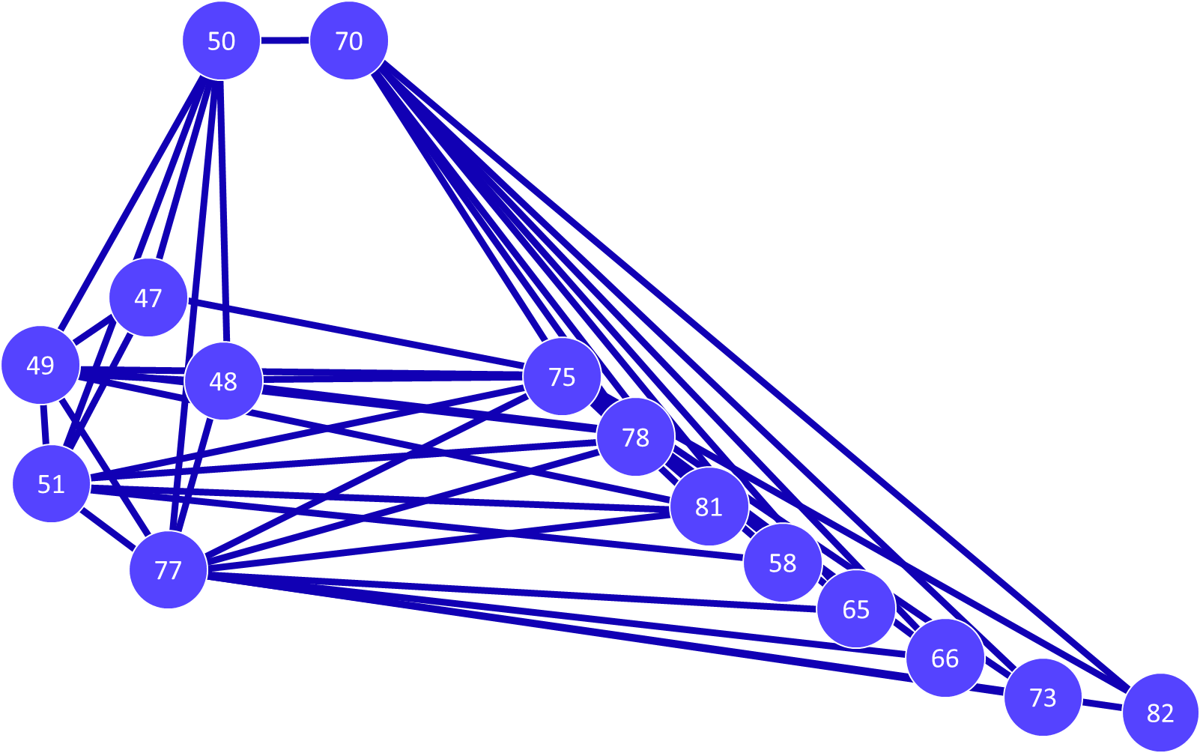
What really happens?

Slide 17
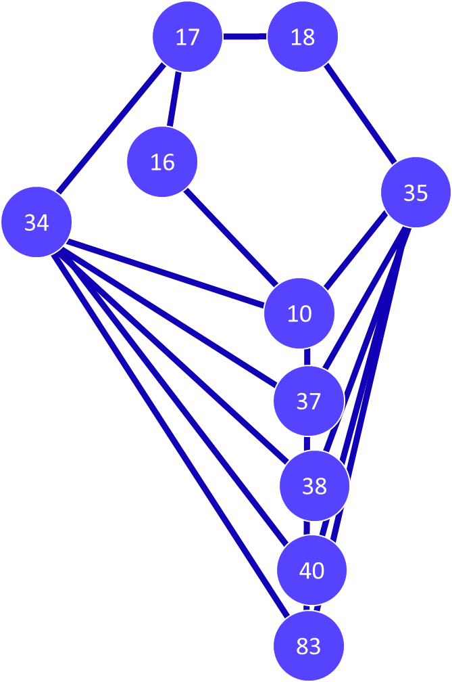
What really happens?

Slide 18
All minimal representatives at birth
Okay, but what about comparing between two brains?

Slide 19
Comparing – accounting for topological, geometric, and biological constraints
Sizemore et al., 2017

Slide 20
Comparing – accounting for topological, geometric, and biological constraints
Sizemore et al., 2017

Slide 21
Comparing – accounting for topological, geometric, and biological constraints
Sizemore et al., 2017

Slide 22
Comparing – accounting for topological, geometric, and biological constraints
Pro: flexible and incorporates different perspectives
Con: takes about a year of graduate student work
Sizemore et al., 2017

Slide 23
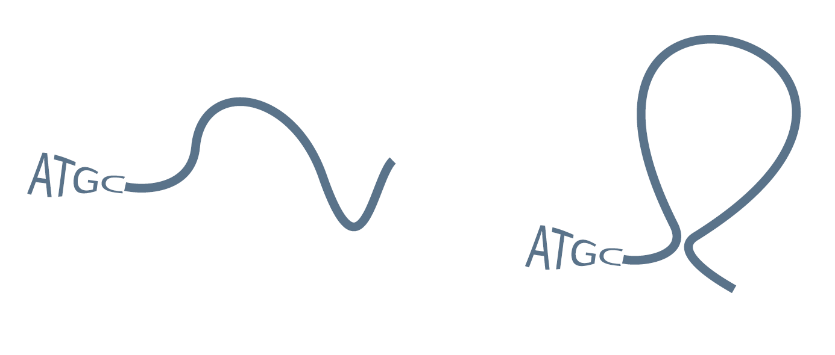
Using biology

Slide 24
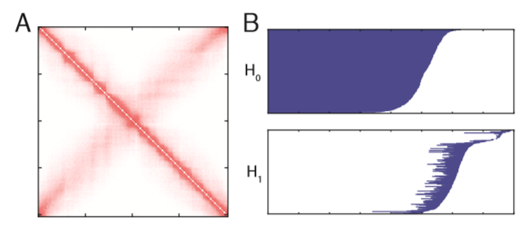
Using biology
Emmett et al., 2015

Slide 25
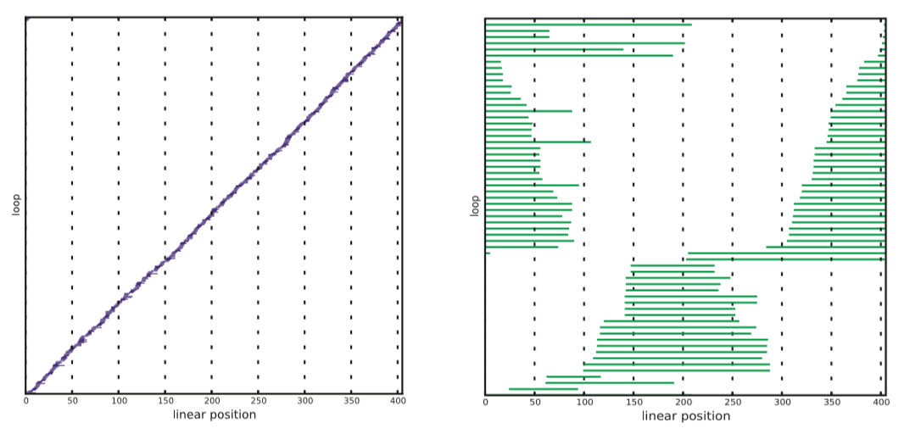
Using biology
Emmett et al., 2015

Slide 26
Is there a better way?

Slide 27
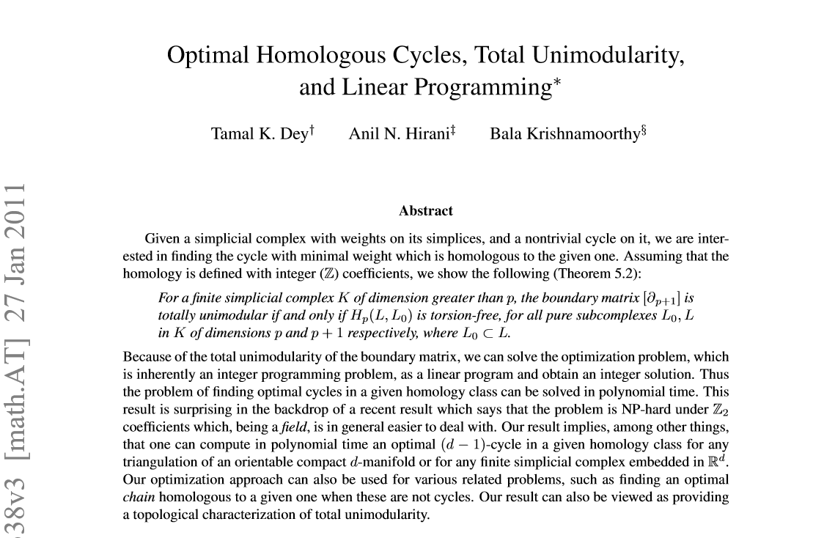

Slide 28
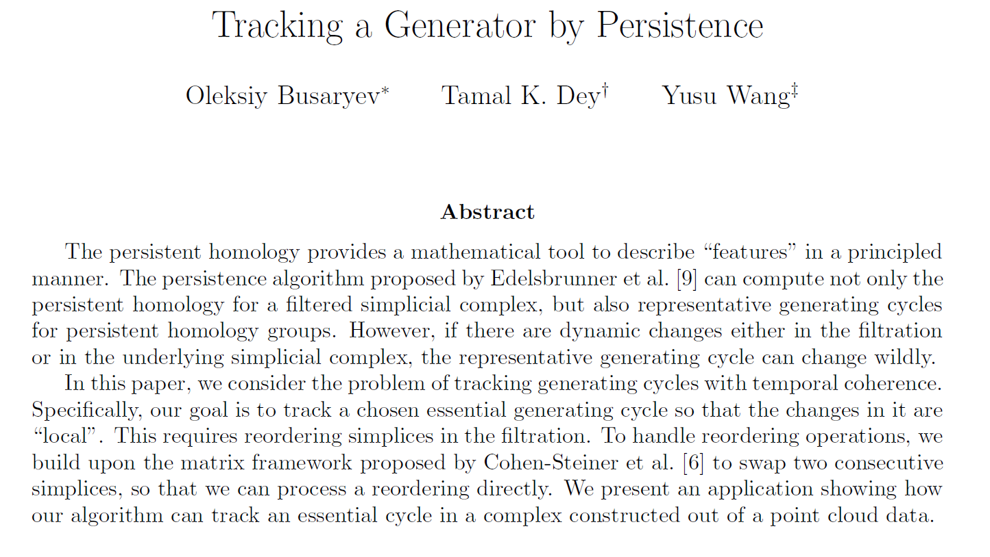

Slide 29
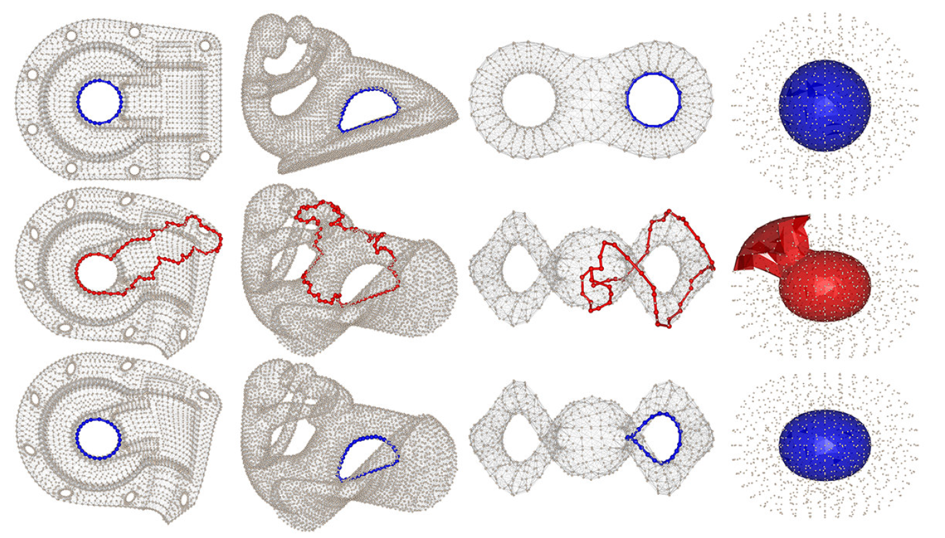
Busaryev et al., 2010

Slide 30
Open question!!!!

